Slide 1
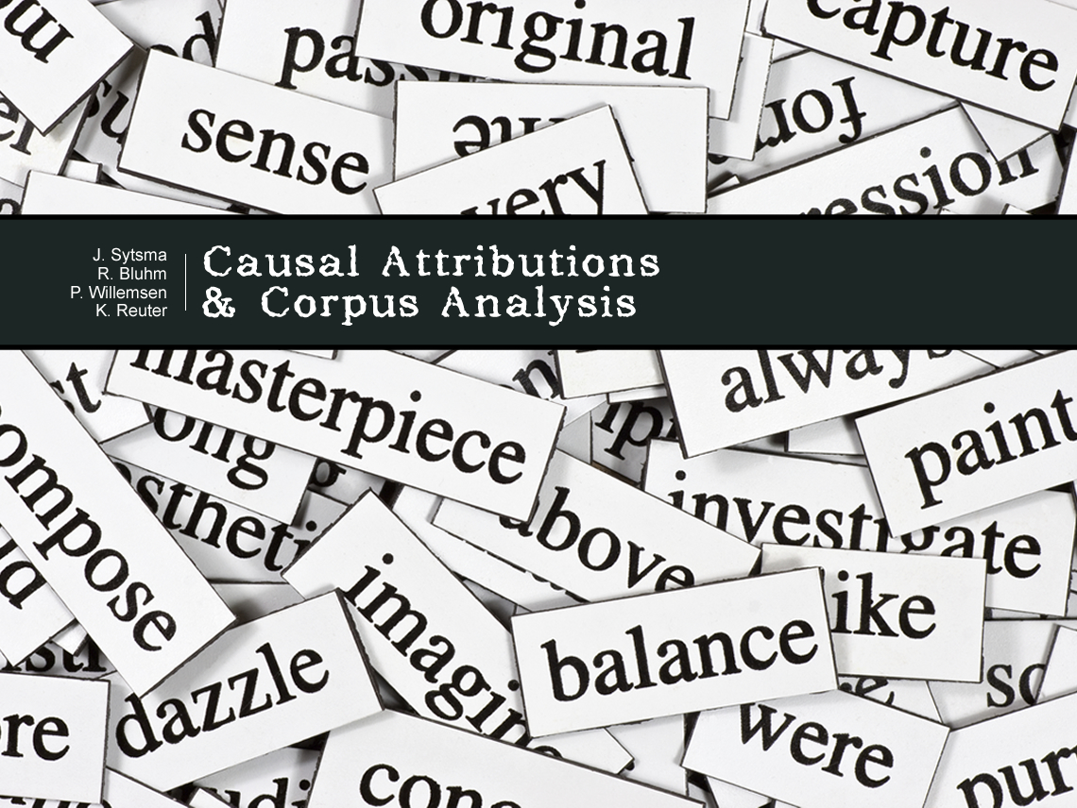

Slide 2


Slide 3
Two goals:
(a) Introduce methods of corpus analysis
(b) Apply these methods to a recent debate concerning ordinary causal attributions

Slide 4
Two goals:
(a) Introduce methods of corpus analysis
(b) Apply these methods to a recent debate concerning ordinary causal attributions

Slide 5
Two goals:
(a) Introduce methods of corpus analysis
(b) Apply these methods to a recent debate concerning ordinary causal attributions

Slide 6
Two goals:
(a) Introduce methods of corpus analysis
(b) Apply these methods to a recent debate concerning ordinary causal attributions

Slide 7

Two goals:
(a) Introduce methods of corpus analysis
(b) Apply these methods to a recent debate concerning ordinary causal attributions

Slide 8
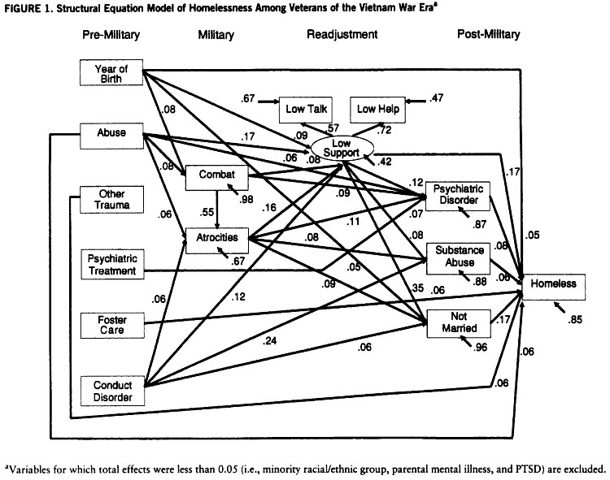
Two varieties of causation…
Structural Causation:
Patterns of statistical association…

Slide 9
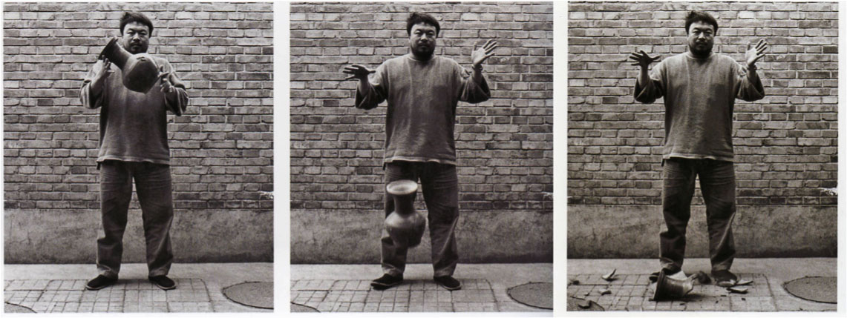
Two varieties of causation…
Structural Causation:
Patterns of statistical association…
Actual Causation:
Accounting for things that have already
happened…
What caused this
vase to break?

Slide 10
Two varieties of causation…
Structural Causation:
Patterns of statistical association…
Actual Causation:
Accounting for things that have already
happened…
This dude?
Causal Selection Problem:
Which factors to elevate
to the status of “cause”
of the actual effect?
Gravity?
Fragility?
Hardness?

Slide 11
Two goals:
(a) Introduce methods of corpus analysis
(b) Apply these methods to a recent debate concerning ordinary causal attributions
This dude caused
this vase to break.
X caused Y.

Slide 12
Two goals:
(a) Introduce methods of corpus analysis
(b) Apply these methods to a recent debate concerning ordinary causal attributions

Slide 13
Two goals:
(a) Introduce methods of corpus analysis
(b) Apply these methods to a recent debate concerning ordinary causal attributions

Slide 14
Background: Norms (especially injunctive
norms) seem to matter for ordinary causal
attributions…
Hilton and Slugoski (1986)
Alicke (1992)
Knobe and Fraser (2008)
Hitchcock and Knobe (2009)
Sytsma, Livengood, and Rose (2012)
Reuter et al. (2014)
Kominsky et al. (2015)
Livengood, Sytsma, and Rose (2016)
And many others…

Slide 15
Typical effect is a direct comparison
in a conjunction case:
Two “agents” perform the same action, bringing about an outcome
Conjunction: jointly necessary
One agent violates an injunctive norm, the other does not
Comparison: causal ratings higher for agent who violates the norm

Slide 16
Example:
Knobe & Fraser (2008), Pen Case
The receptionist in the philosophy department keeps her desk stocked with pens. The administrative assistants are allowed to
take the pens, but faculty members are supposed to buy their own.
The administrative assistants typically do take the pens. Unfortunately, so do the faculty members. The receptionist has repeatedly emailed them reminders that only administrative assistants are allowed to take the pens.
On Monday morning, one of the administrative assistants encounters Professor Smith walking past the receptionist’s desk. Both take pens. Later that day, the receptionist needs to take an important message… but she has a problem. There are no pens
left on her desk.
Mean=2.2
Mean=-1.2
Agree with statement (-3=not at all; 0=somewhat; 3=fully):
Professor Smith caused the problem.
The administrative assistant caused the problem.

Slide 17
Example:
Livengood et al. (2016) based on Knobe (2006)
Lauren and Jane both work for a company that uses a mainframe that can be accessed from terminals on different floors of its building. The mainframe has recently become unstable, so that if more than one person is logged in at the same time, the system crashes. Therefore, the company has instituted a temporary policy restricting the use of terminals so that two terminals are not used at the same time until the mainframe is repaired. The policy prohibits logging into the mainframe from the terminal on any floor except the ground floor.
One day, Lauren logged into the mainframe on the authorized terminal on the ground floor at the exact same time that Jane logged into the mainframe on the unauthorized terminal on the second floor. Lauren and Jane were both unaware that the other was logging in. Sure enough, the system crashed.
Mean=5.21
Mean=2.42
Agree with statement (1=strongly disagree; 4=neutral; 7=strongly agree):
Jane caused the system to crash.
Lauren caused the system to crash.

Slide 18
Striking finding from recent work on
causal attribution:
Causal ratings correspond with whether
or not an injunctive norm was violated.
Four types of explanation:
pragmatic view
counterfactual view
bias view
responsibility view

Slide 19
Striking finding from recent work on
causal attribution:
Causal ratings correspond with whether
or not an injunctive norm was violated.
Four types of explanation:
pragmatic view
counterfactual view
bias view
responsibility view

Slide 20
Pragmatic View
e.g., Samland and Waldmann (2016)
Skeptical position: features of probes
lead participants to interpret the question
in terms of an alternative concept, such as
accountability or responsibility.

Slide 21
Counterfactual View
e.g., Hitchcock and Knobe (2009)
Causal judgments identify suitable
intervention points; injunctive norms relevant
to suitability.
Basic idea: people think about how an
outcome could have been prevented,
focusing on changing those aspects of
the situation that are abnormal….

Slide 22
Responsibility View
e.g., Sytsma, Livengood, and Rose (2012)
Relevant causal attributions are normative.
Used to indicate more than that an entity
brought about or produced an outcome;
gives a normative evaluation similar to
saying the entity is responsible for or
accountable for the outcome.

Slide 23
Evidence from a variety of different types of
questionnaire studies has been put forward for
these different views.
Including evidence for my view…
But today I’ll focus on another source of
evidence that has been brought to bear
on these debates: corpus analysis

Slide 24
Two goals:
(a) Introduce methods of corpus analysis
(b) Apply these methods to a recent debate concerning ordinary causal attributions

Slide 25
Two goals:
(a) Introduce methods of corpus analysis
(b) Apply these methods to a recent debate concerning ordinary causal attributions

Slide 26
(1) Can corpus analysis provide independent support for the thesis that ordinary causal attributions are sensitive to normative information?
(2) Does the evidence coming from corpus analysis support the contention that outcome valence matters for ordinary causal attributions?
(3) Are ordinary causal attributions similar to responsibility attributions?
(4) Are causal attributions of philosophers different from causal attributions we find in corpora of more ordinary language?

Slide 27
Start with some methods that are
non-mathematical…
Use search features available online
for COCA: https://corpus.byu.edu/coca/
Does the context for ordinary causal
attributions tend to be valenced?
(i.e., do we tend to attribute causation
more often for bad things than good?)
Search for nouns occurring after
“caused the” in the corpus

Slide 28
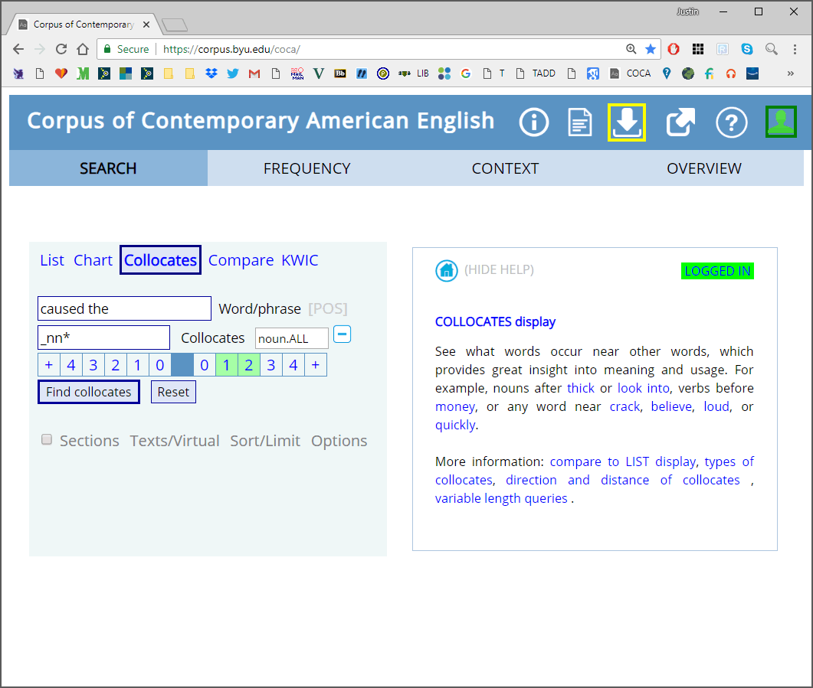

Slide 29
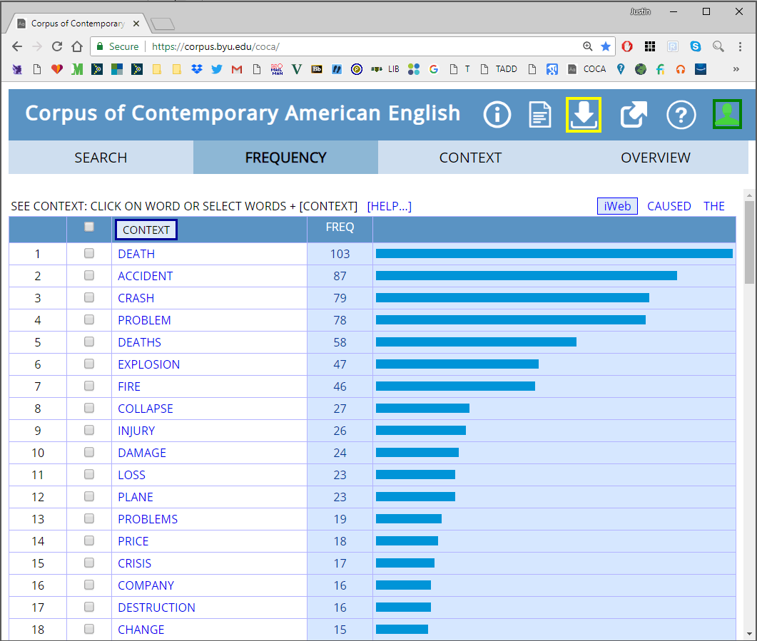
Independent Raters
Top 10 all negative
And 30 of the top 50
Only 1 positive

Slide 30
Objection: Newspapers are one source
used in COCA. And they are notorious
for focusing on negative events.
Reply: Limit the search to other sources.

Slide 31
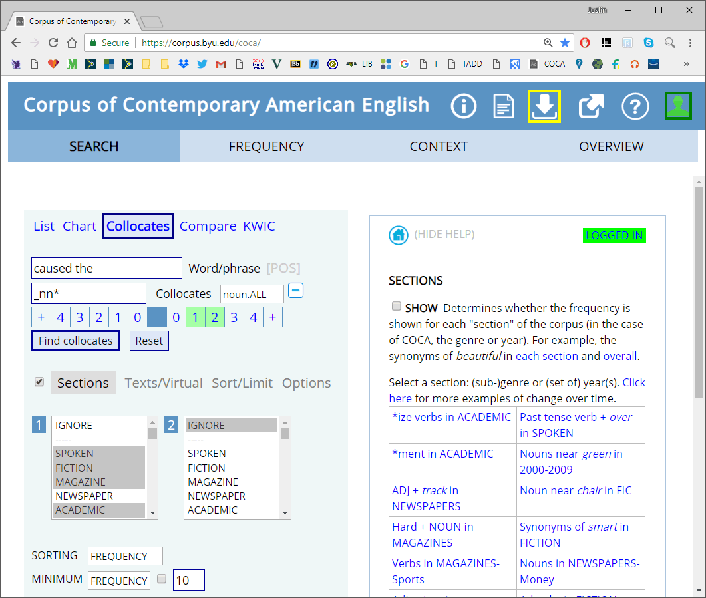

Slide 32
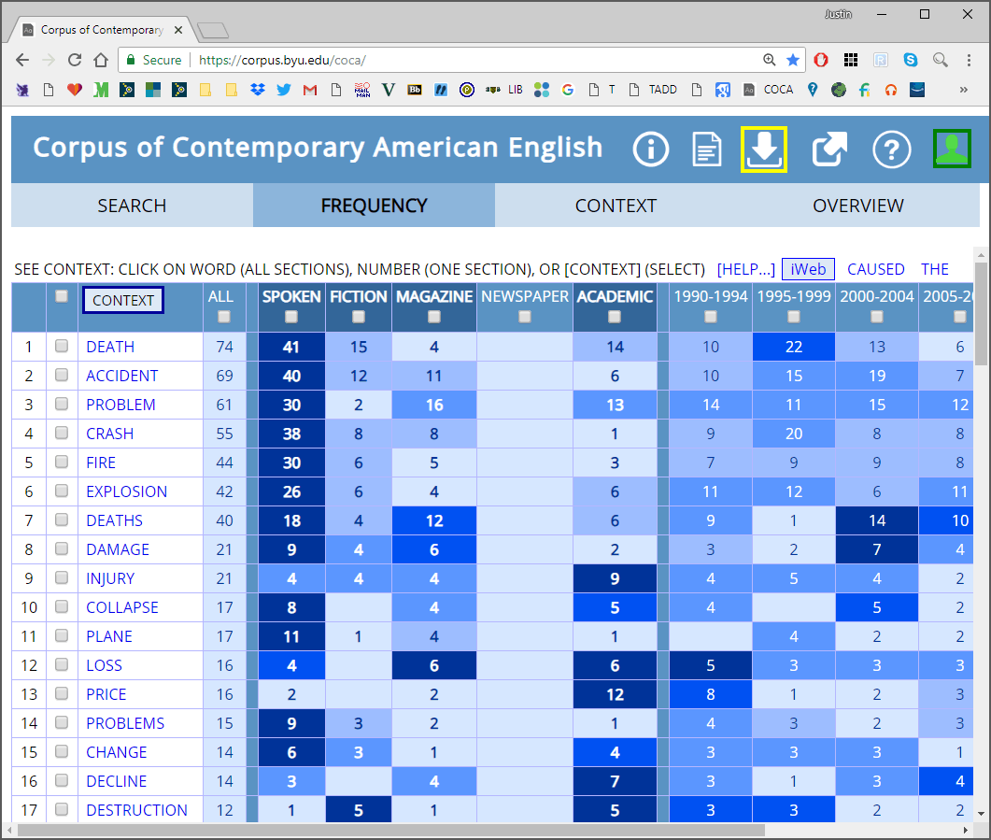

Slide 33

Objection: Negativity is part of the
human condition.
Reply: Check other terms listed as
synonyms of the verb “cause.”

Slide 34
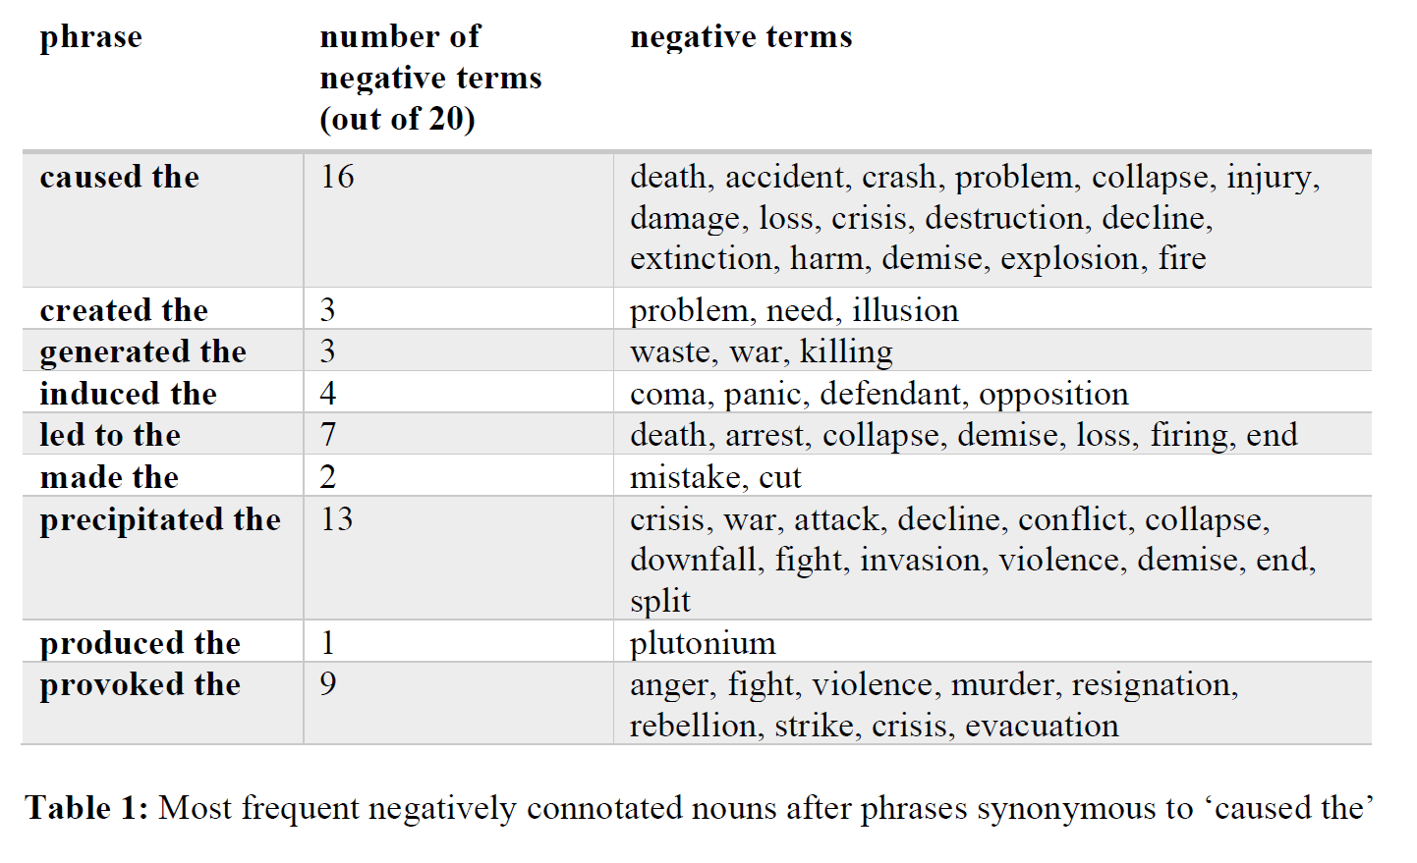
Are responsibility attributions similar?

Slide 35
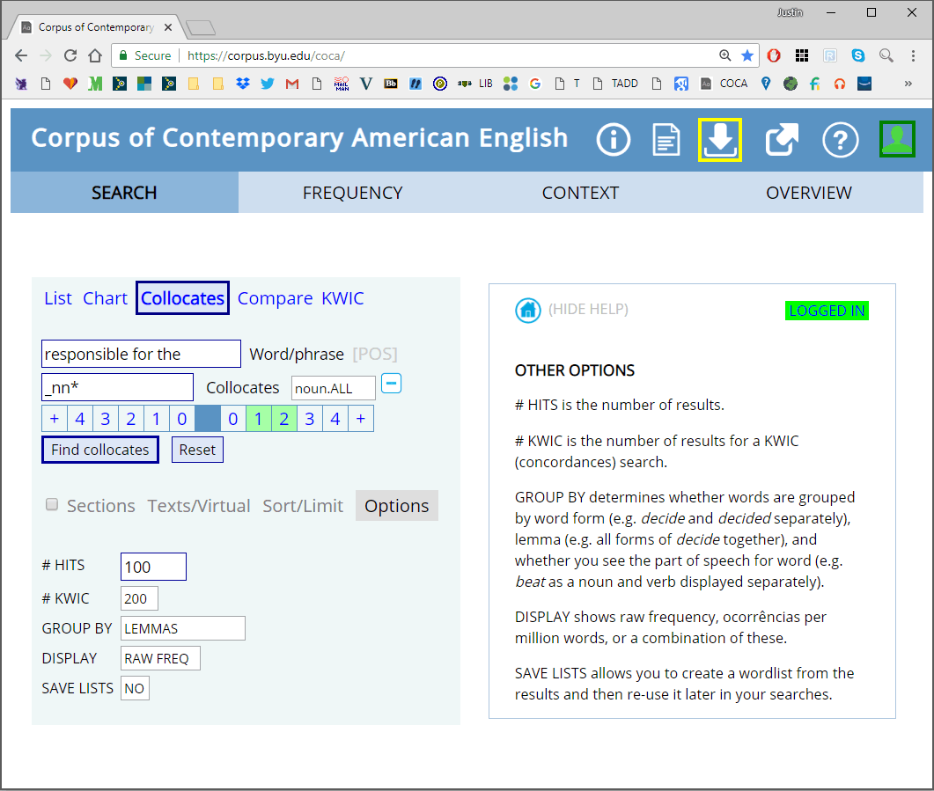

Slide 36
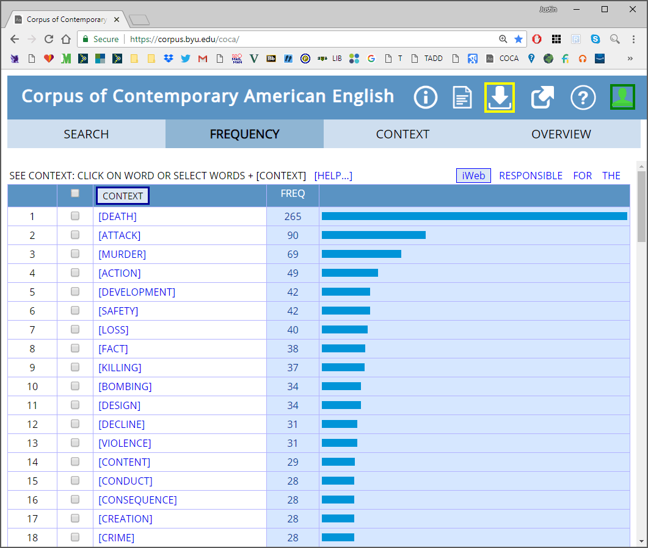
Independent Raters
Top 10 all negative
And 19 of the top 50
14 positive
But many indicate
a different sense…

Slide 37
Also more mathematical methods…
“you shall know a word by the company
it keeps” (Firth 1957, 11)
Distributional Semantic Models (DSMs)
Represent terms as geometric vectors
in high-dimensional “semantic” space.
Cosine of vectors as measure of
semantic relatedness.

Slide 38
Latent Semantic Analysis (LSA):
“bag-of-words” approach
Window-based methods (HAL)
Context-predicting methods (word2vec)
Details can get daunting.
But some relatively easy tools you
can use to get started…

Slide 39
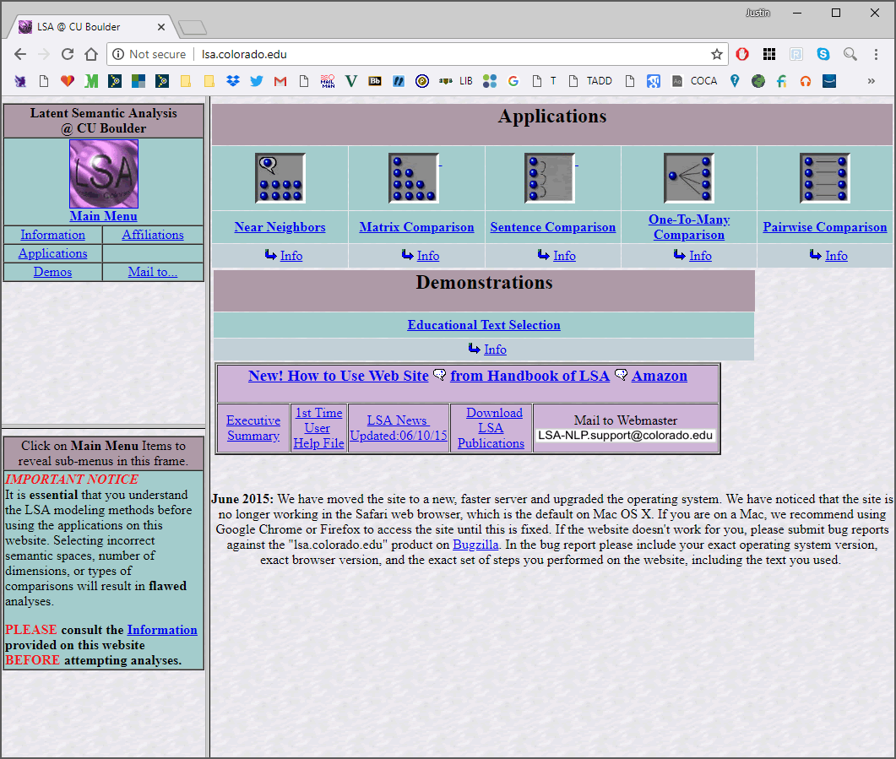

Slide 40
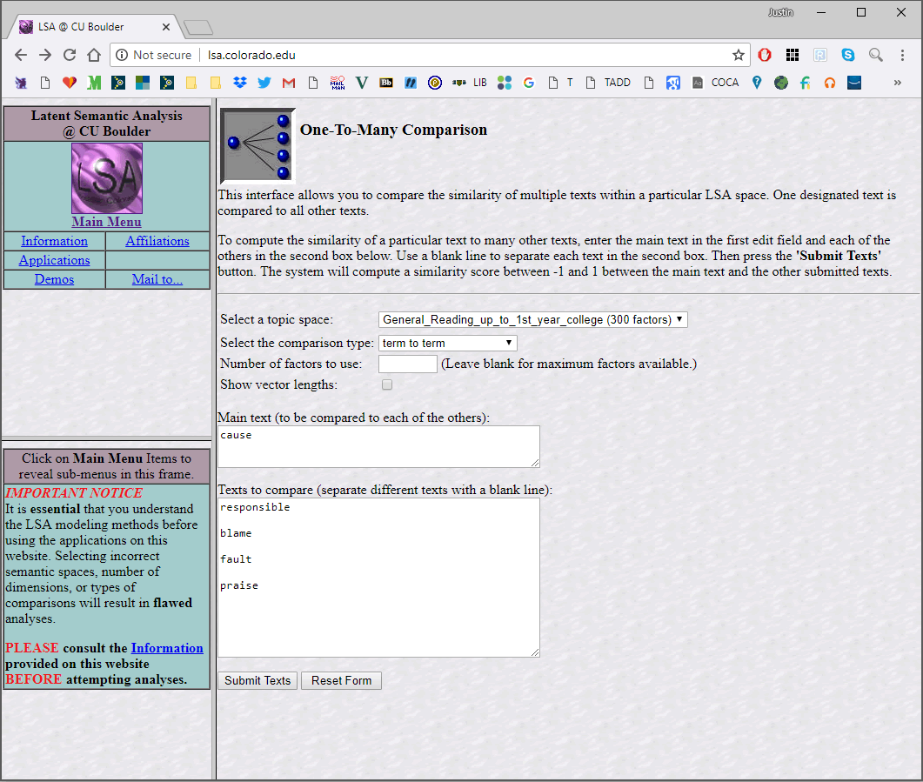

Slide 41
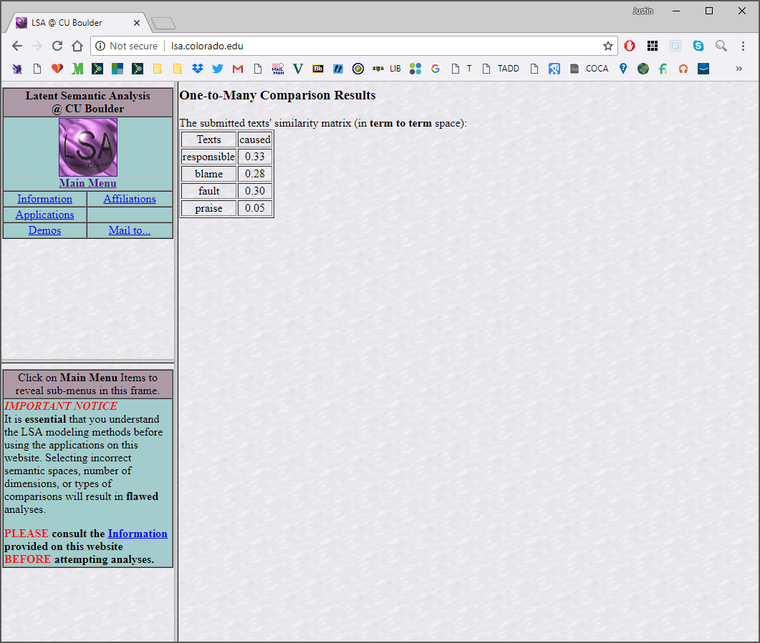

Slide 42
What do these numbers mean?!
“dog” and “wolf” = 0.30
“dog” and “animal” = 0.15
“dog” and “sandwich” = 0.08
BETTER: a systematic set of comparisons,
such as MEN benchmark…
Bruni, Tran, and Baroni (2013), “Multimodal
Distributional Semantics,” Journal of Artificial
Intelligence Research, 48.

Slide 43
http://clic.cimec.unitn.it/~elia.bruni/MEN
https://github.com/vecto-ai/word-benchmarks
1,000 pairs of words for evaluation
Semantic relatedness of each pair assessed
using Mturk workers
0-50 scale

Slide 44
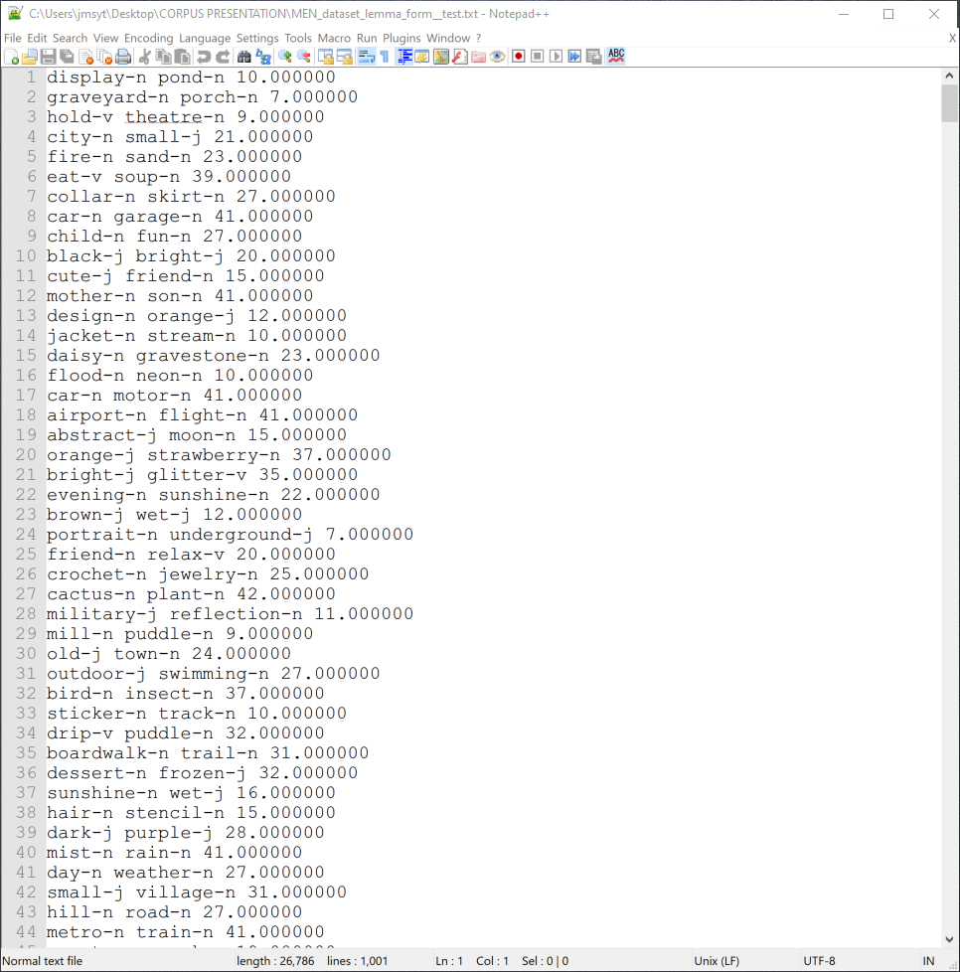

Slide 45
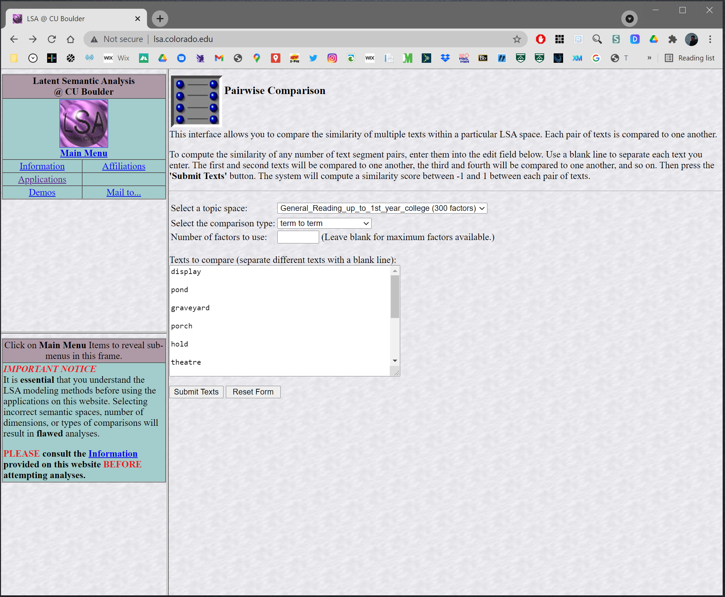

Slide 46
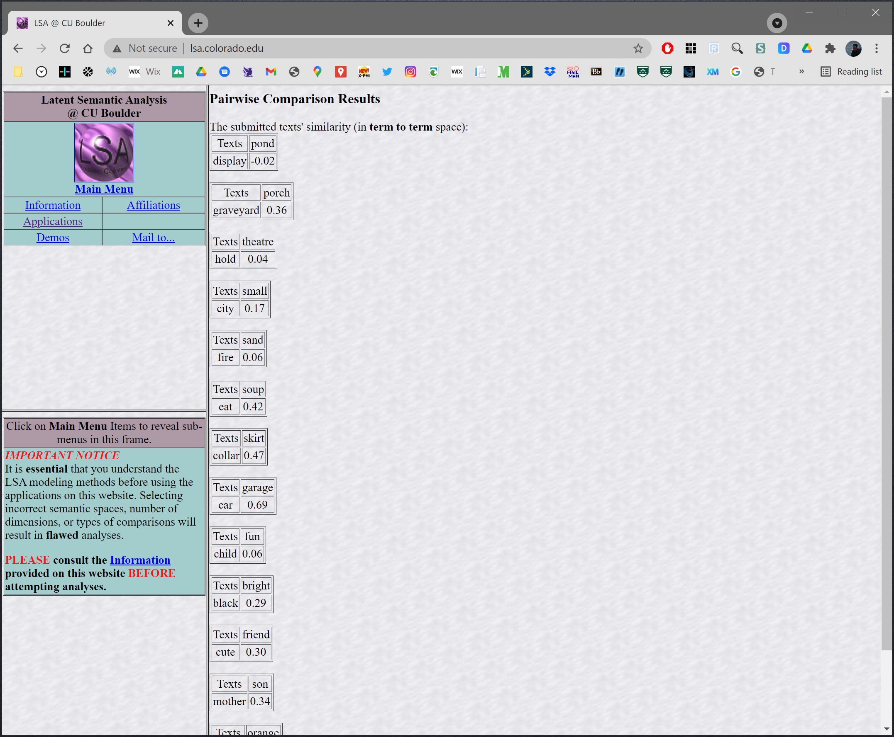

Slide 47
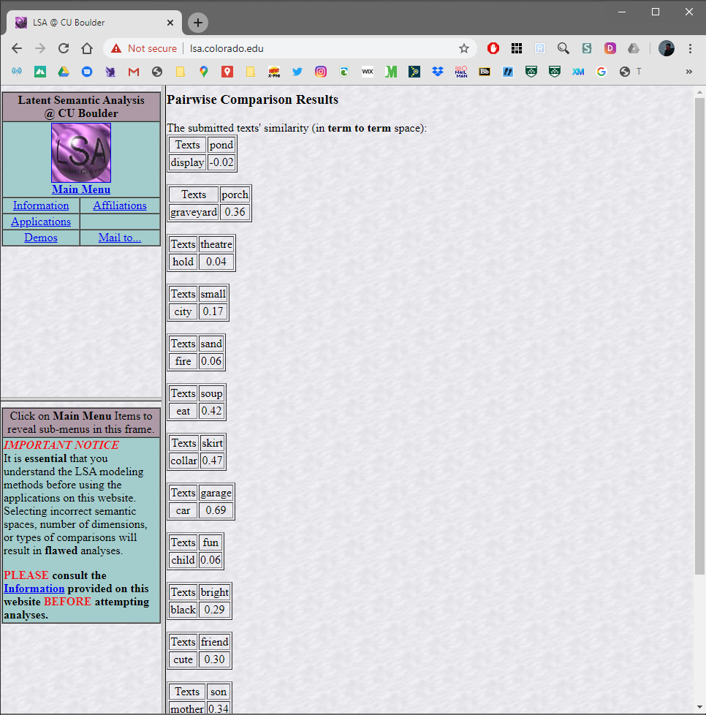
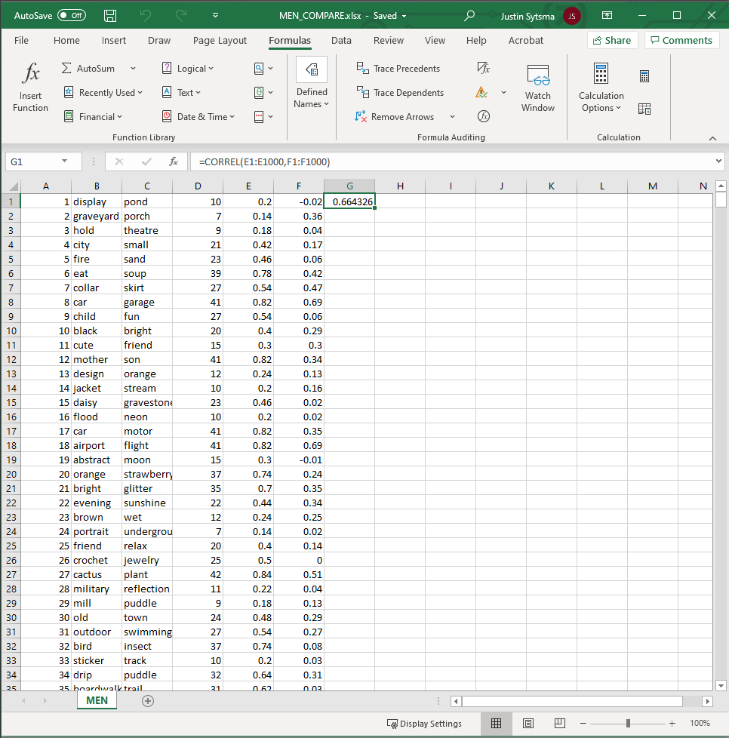
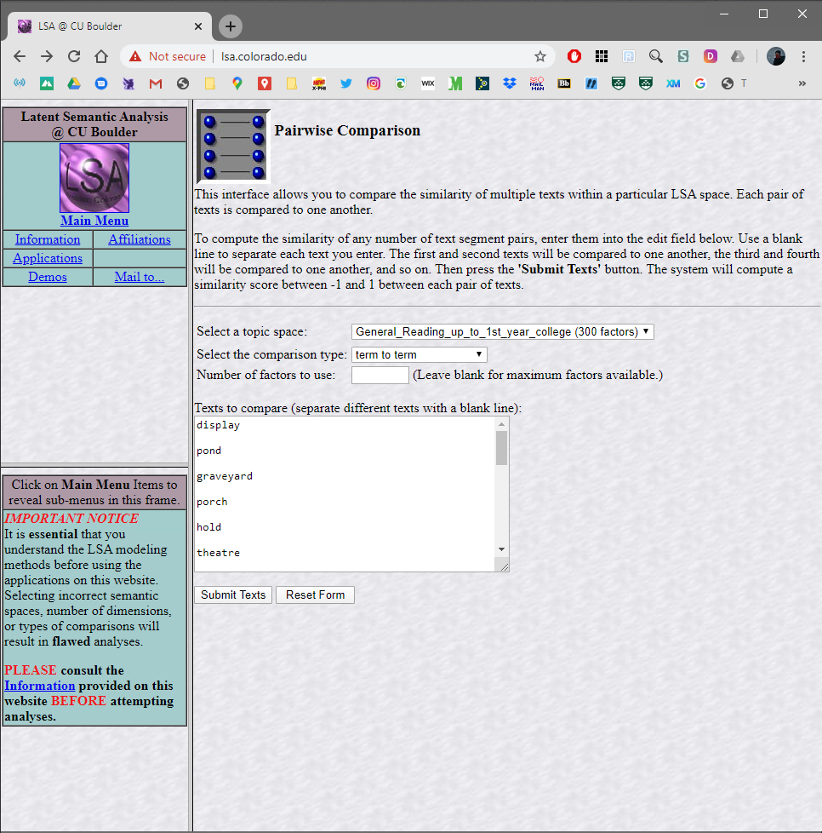

Slide 48
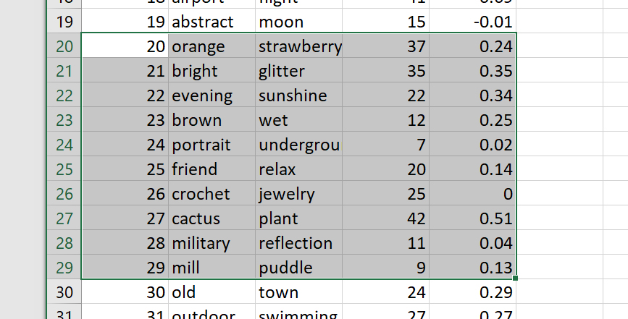
Let’s find Spearman’s Rho for items 20-29
(“MEN_dataset_lemma_form__test.txt”)
for “General_Reading_up_to_1st_year_college”
at lsa.colorado.edu

Slide 49
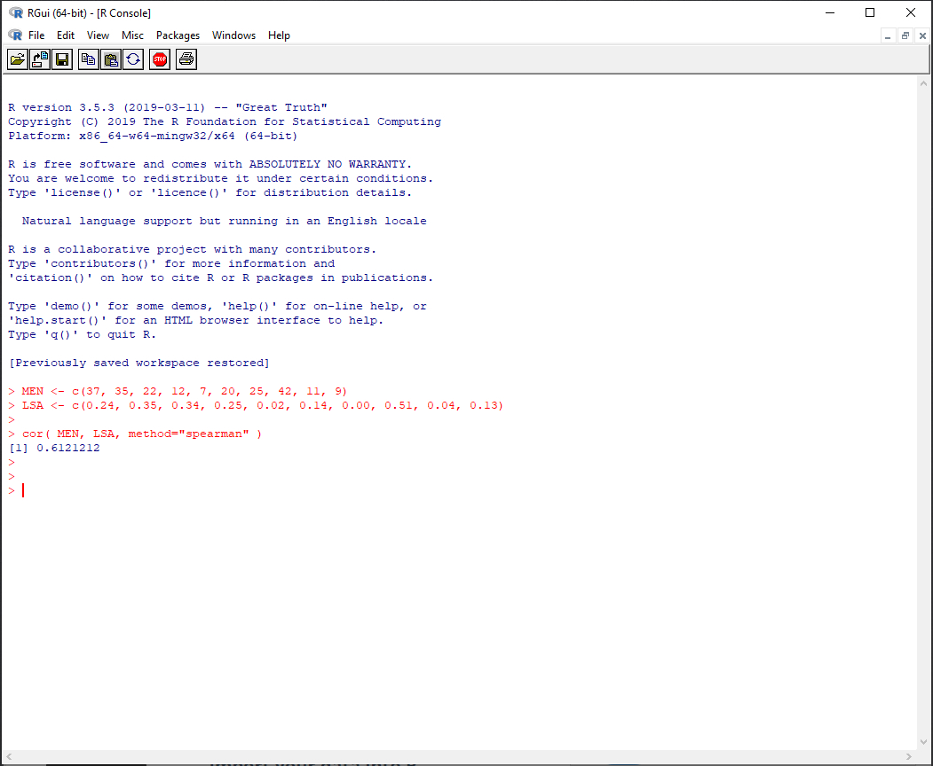
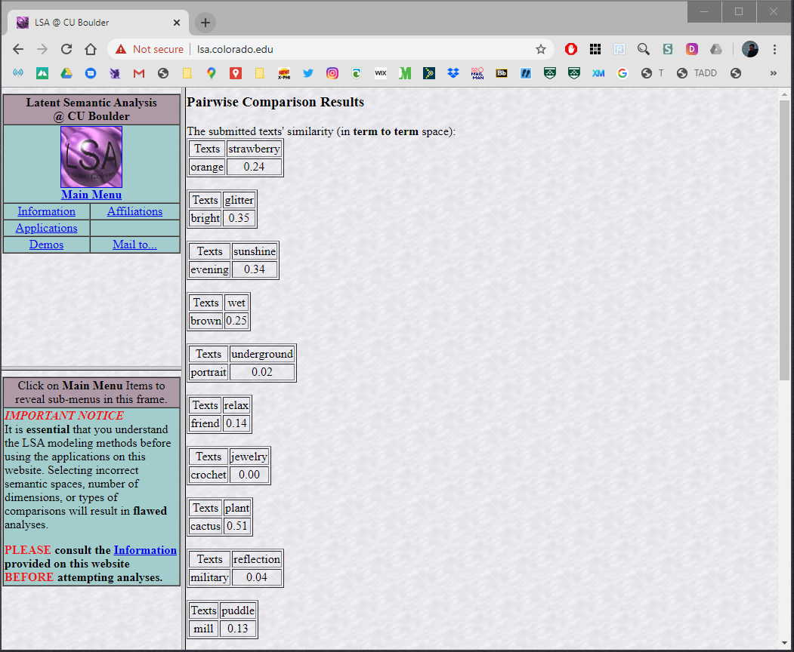

Slide 50
Overall, Spearman’s rho = 0.67
Another option is to look at “nearest
Neighbors” for the terms of interest:
The terms closest to a term in the
semantic space (i.e., terms with highest
cosine values with the target term)

Slide 51
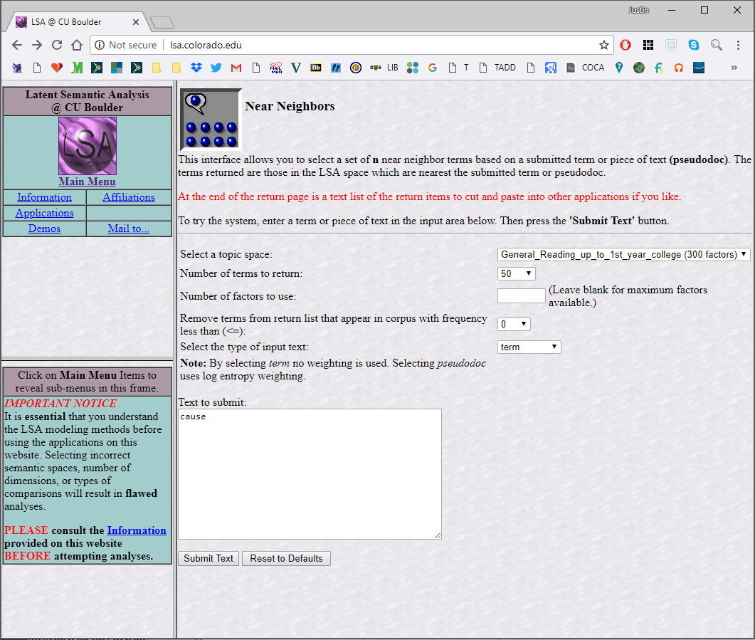

Slide 52
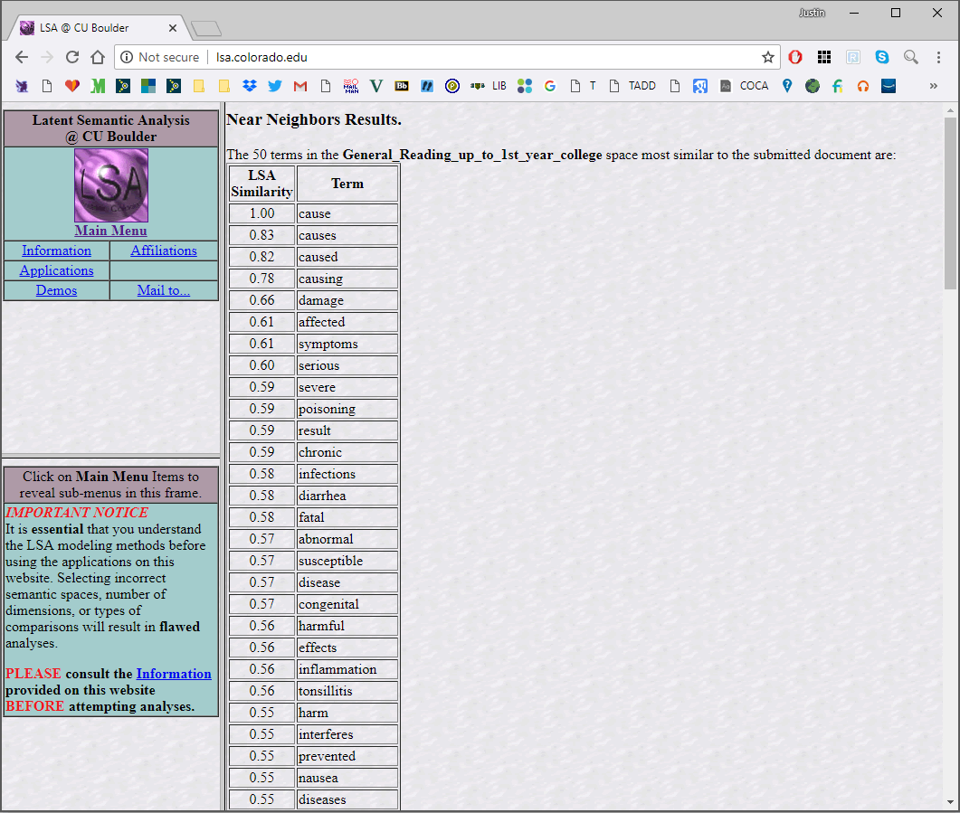
Note: this space isn’t
using lemmas (merging
base word and its
inflections) or
distinguishing parts
of speech.

Slide 53
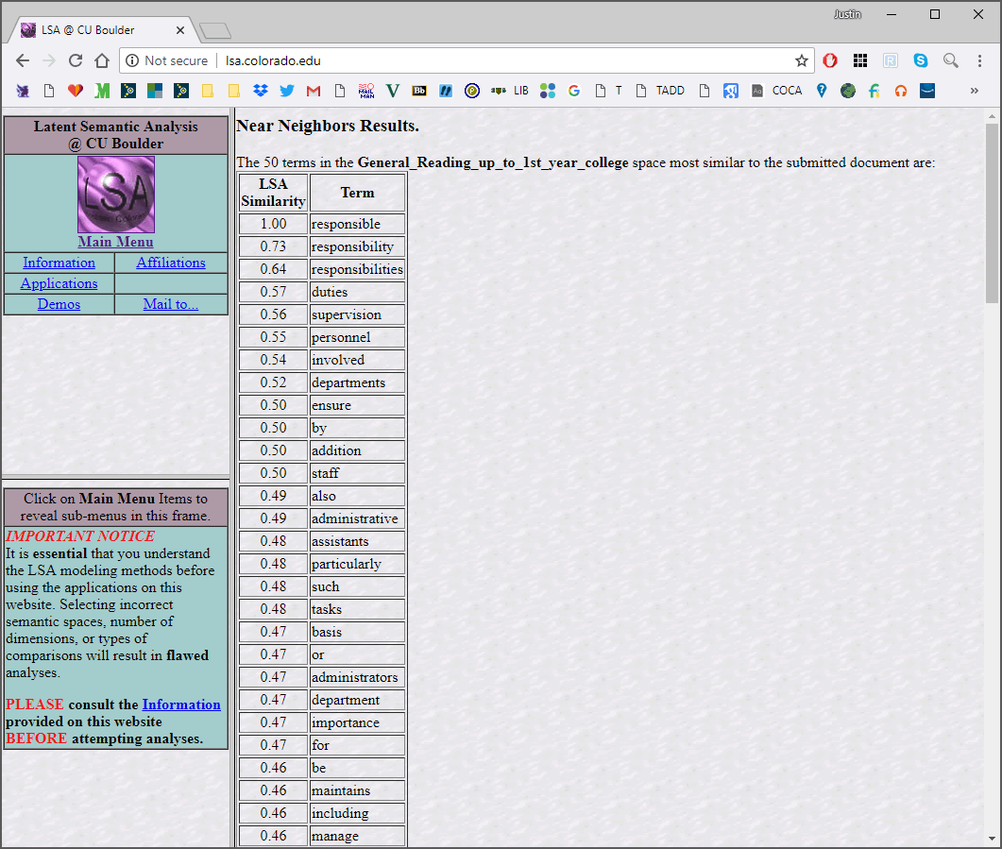

Slide 54
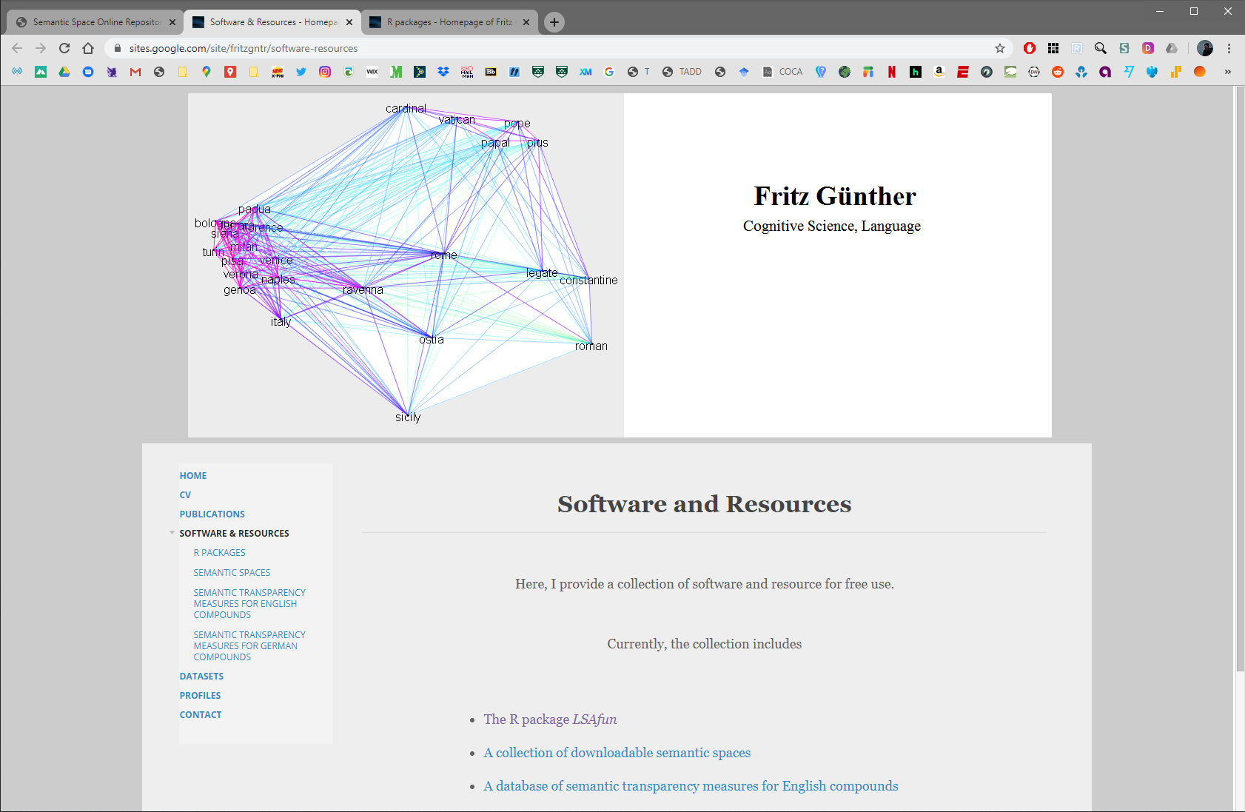
Can also load prebuilt spaces into R
https://sites.google.com/site/fritzgntr/home

Slide 55
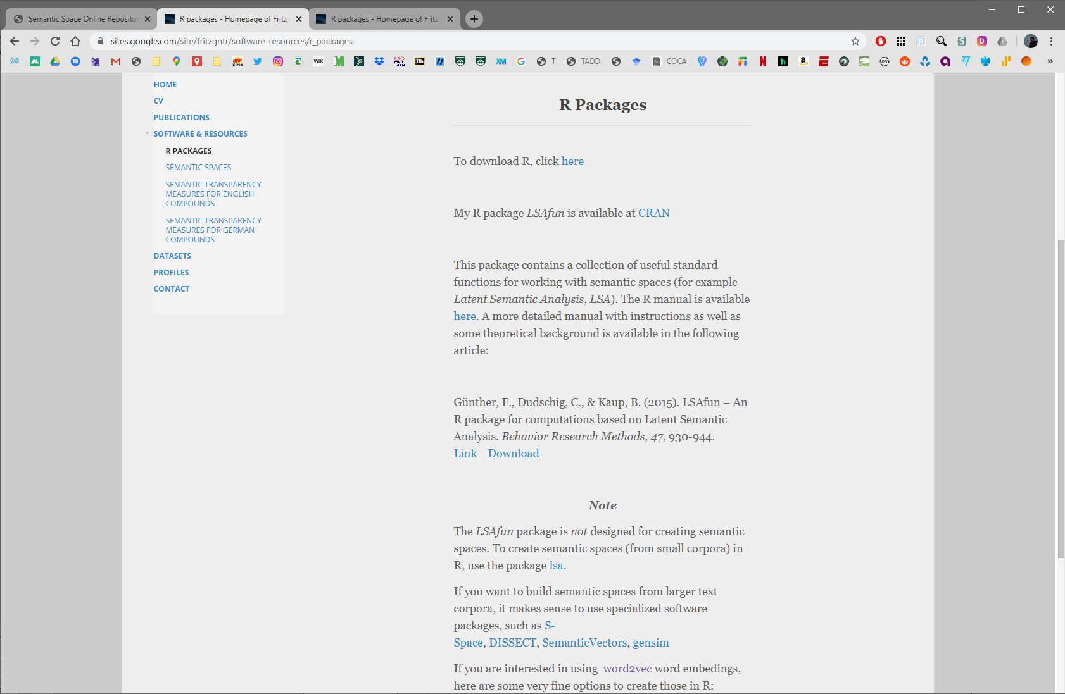
We’ll look at lsa in a minute.
But the caveat is important:
R is not ideal for creating
semantic spaces for larger
corpora due to memory
issues.
For many purposes the
prebuilt spaces for LSAfun
will do everything you need!
And impressive new spaces
have been added since we
wrote this chapter.

Slide 56
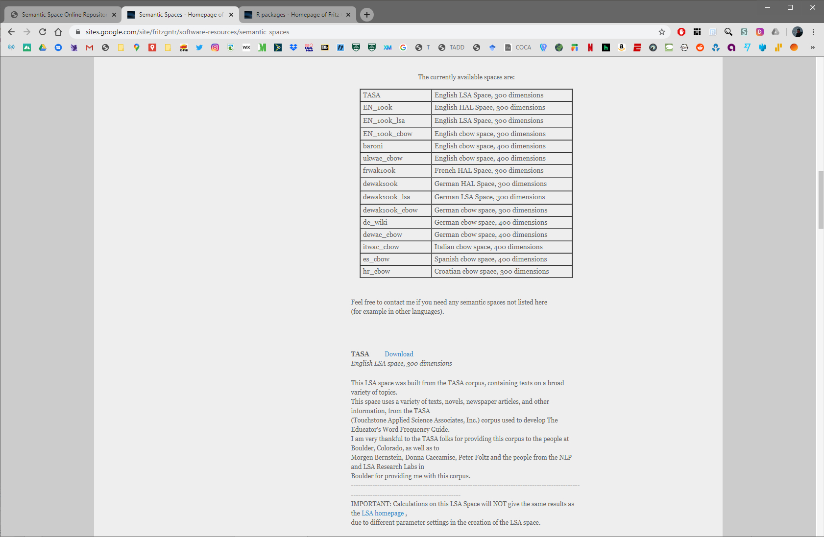

Slide 57
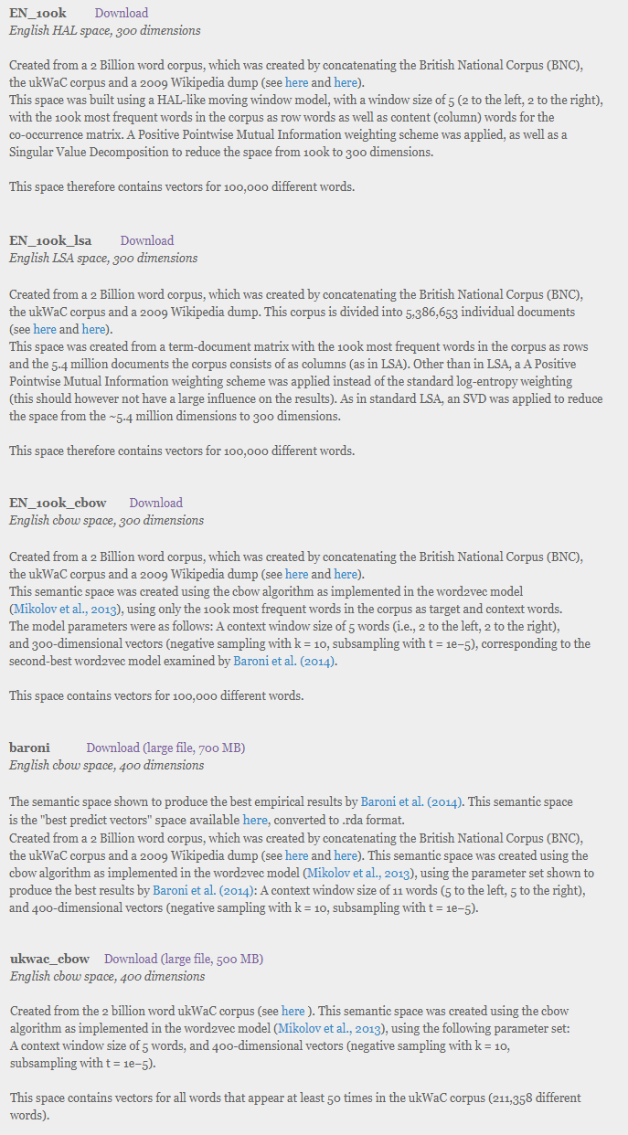
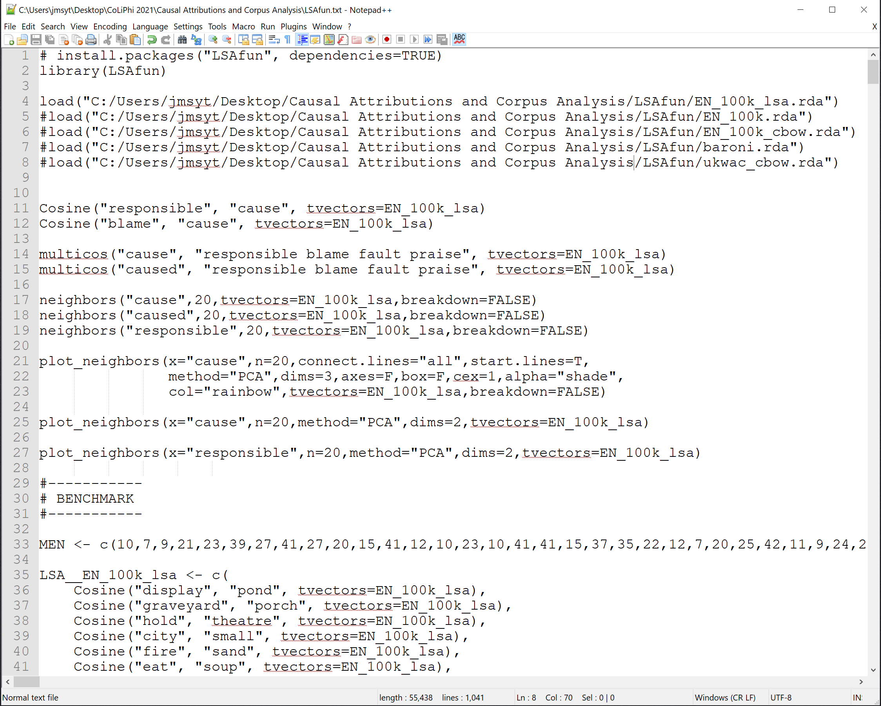
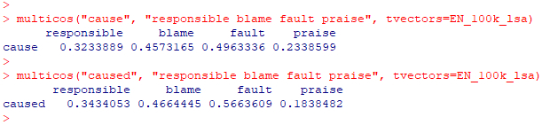
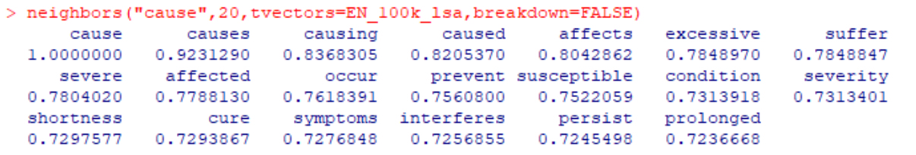

Slide 58
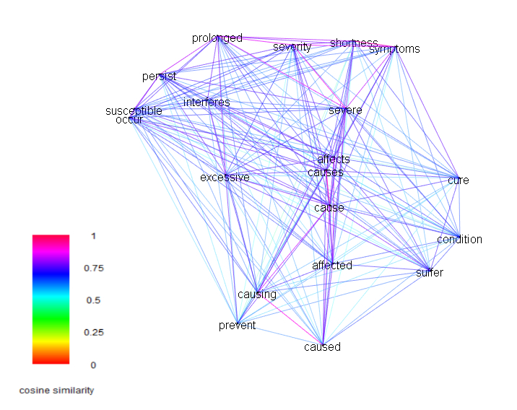
Download space &
run in R to rotate!

Slide 59
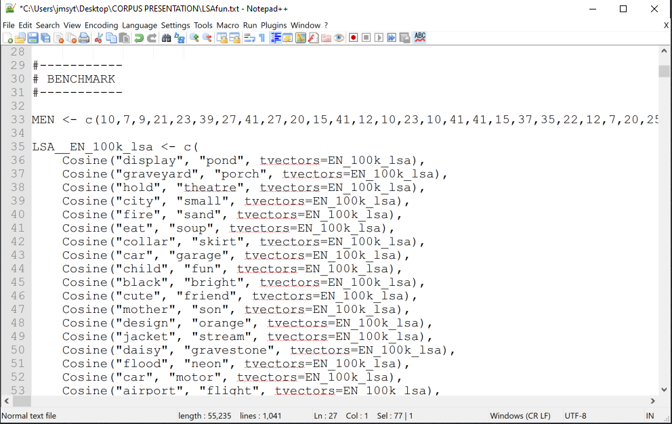
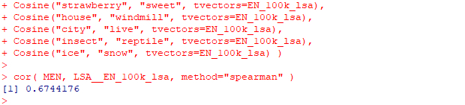
Benchmark?

Slide 60
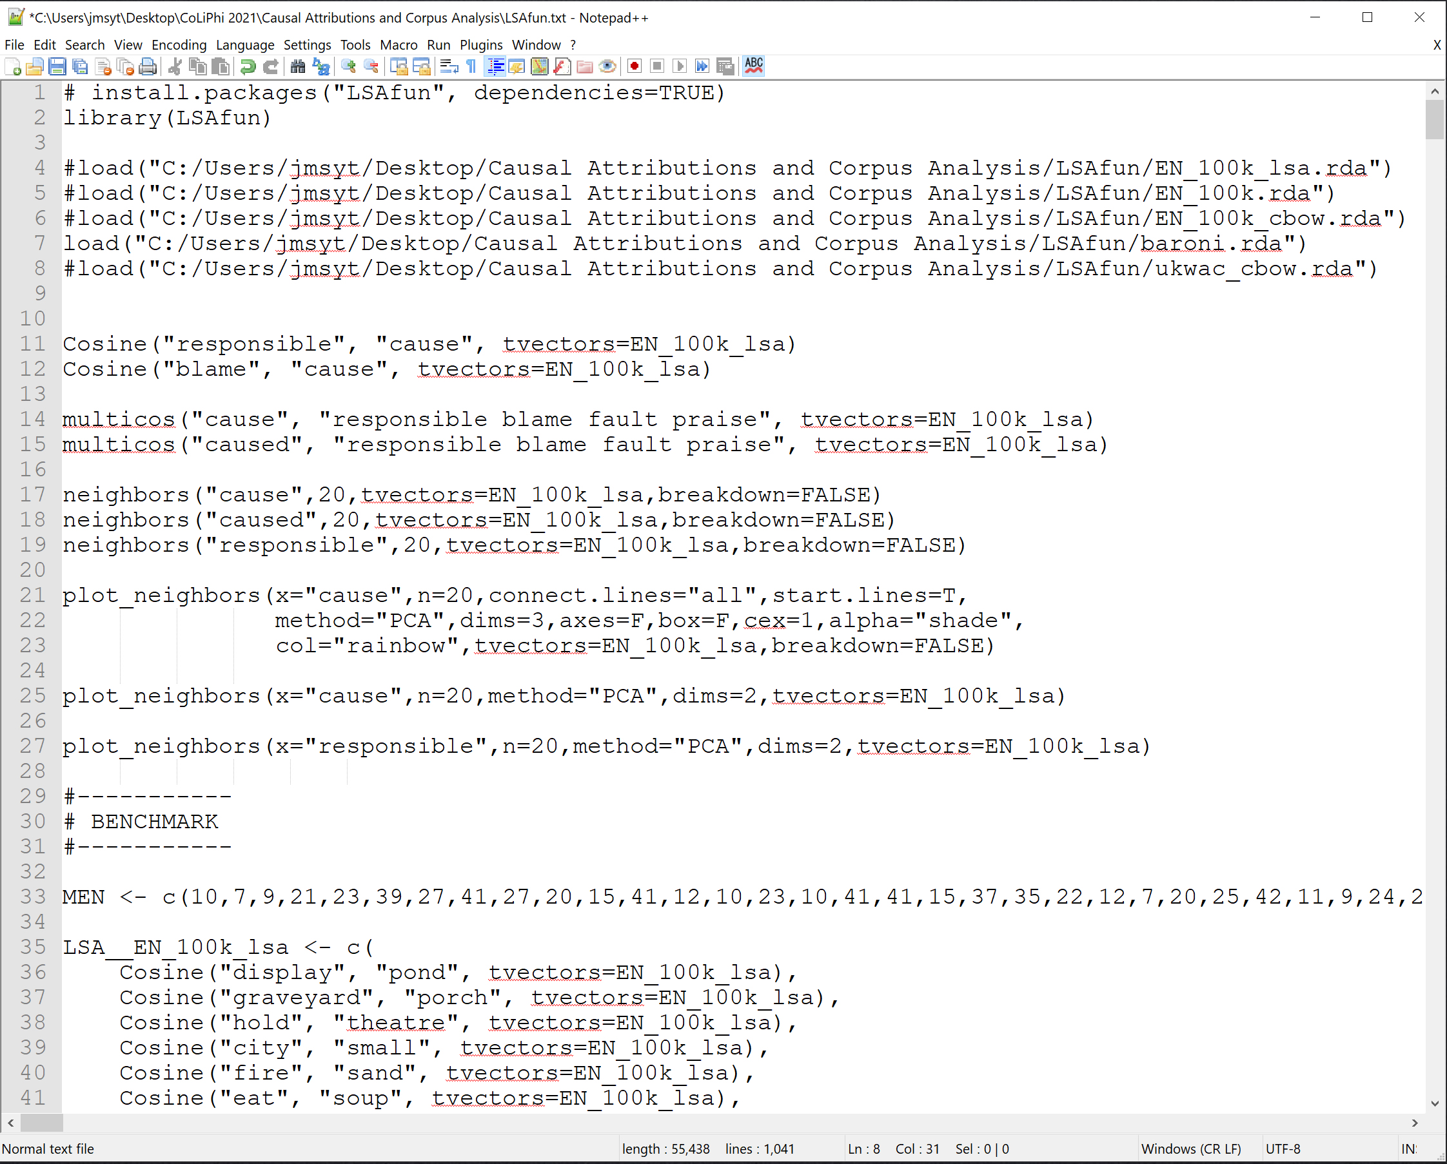
Let’s download other semantic spaces
from https://sites.google.com/site/fritzgntr/home
and modify “LSAfun.txt” to see how the perform
on the MEN benchmark.

Slide 61
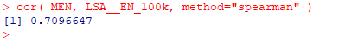
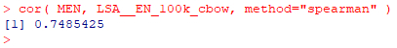
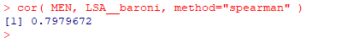
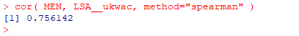

Slide 62
Limited to the spaces that have been built.
Wanted to lemmatize and look at two
multi-word expressions (“caused the,”
“responsible for the”).
And we wanted to compare to philosophical use.
Can also build corpora and semantic spaces in
R (although notable limitations for large corpora).
We’ll create a toy “philosophy” corpus, then
build LSA and word2vec spaces for it in R.

Slide 63
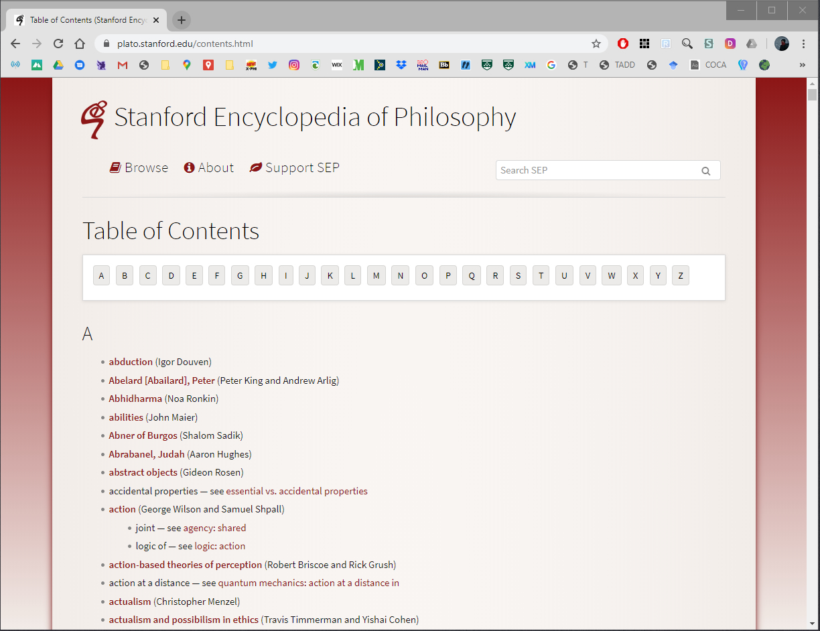
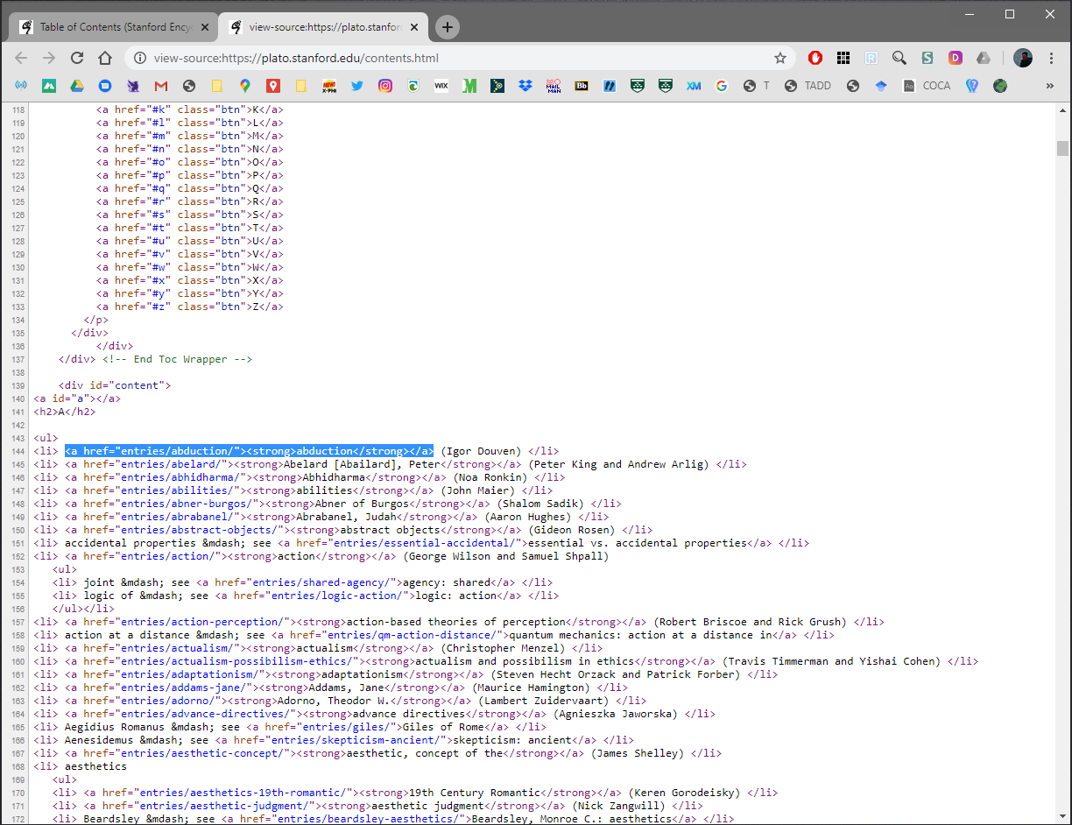
We’ll begin by scraping text from the SEP:
RCurl to get HTML and text manipulation functions in stringr to extract the relevant bits.

Slide 64
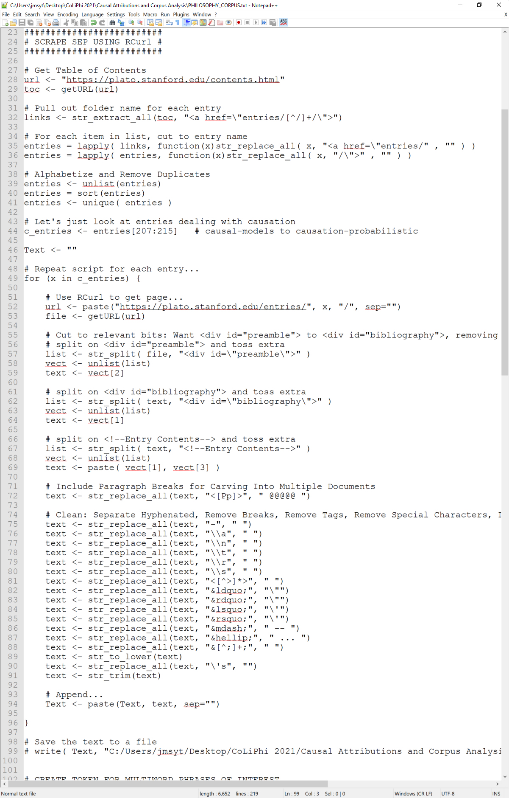
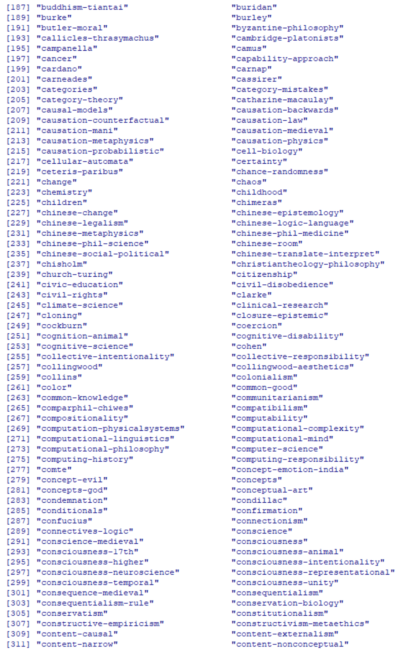

Slide 65
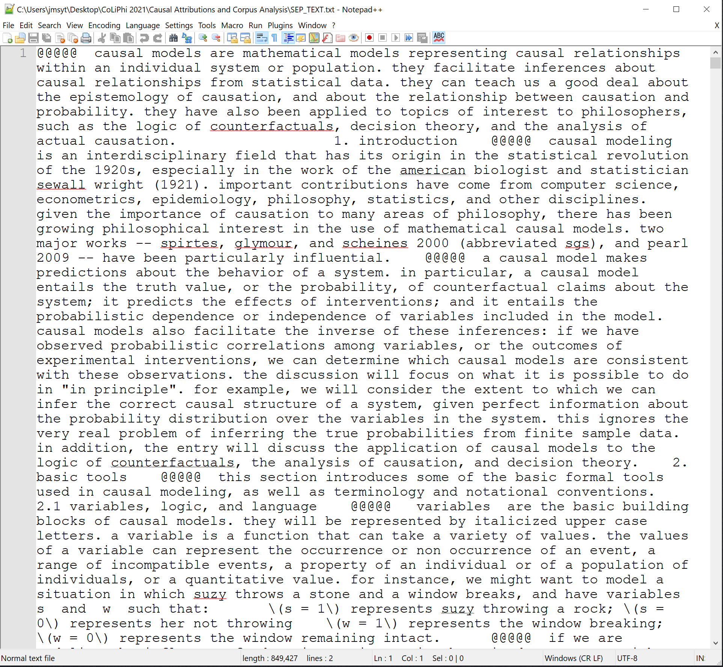
Loop through entries
Pulling the html
Isolating the relevant text
Marking paragraph breaks
Doing preliminary cleaning
And putting entries together

Slide 66
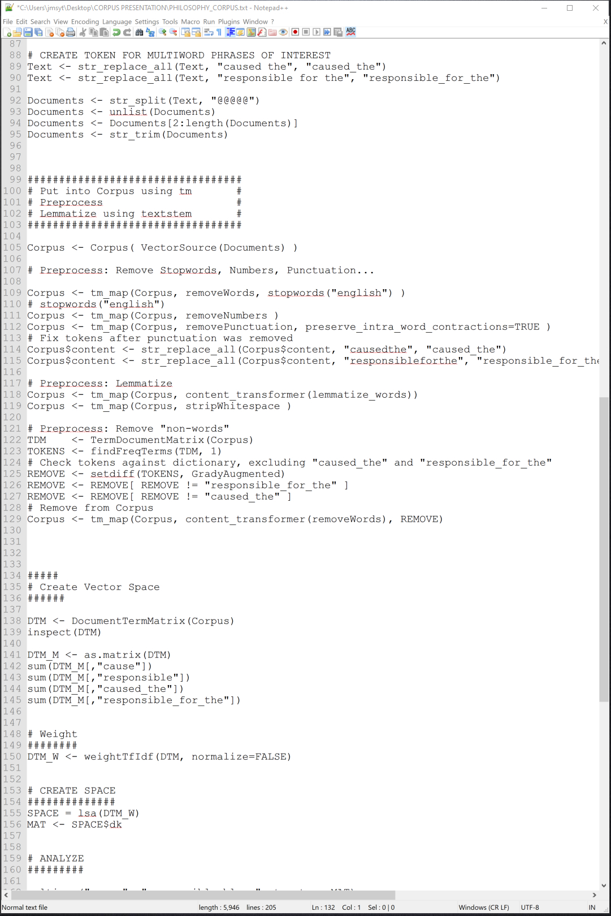
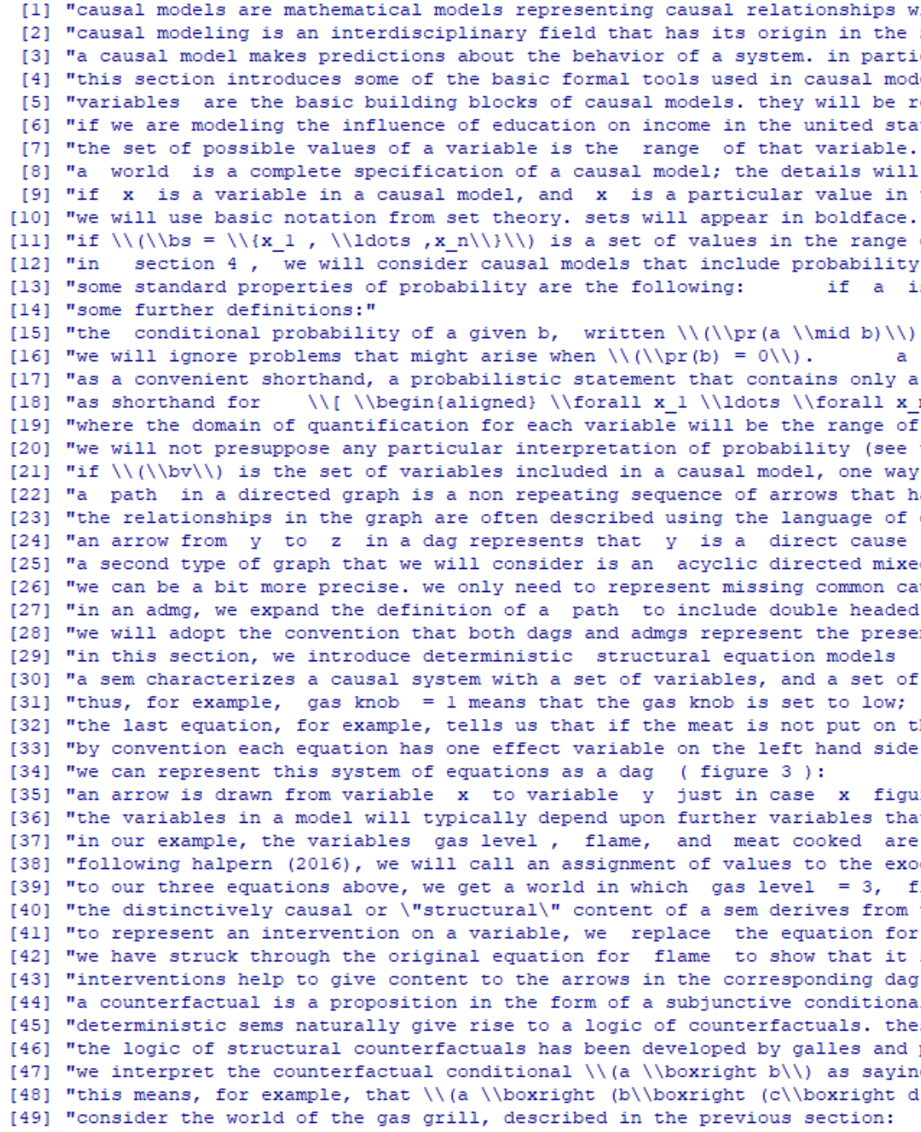
Here we can mark any
multiword phrases we
want to analyze as a
single unit.
Divide into documents
(our bags-of-words);
here we’ll do paragraphs

Slide 67
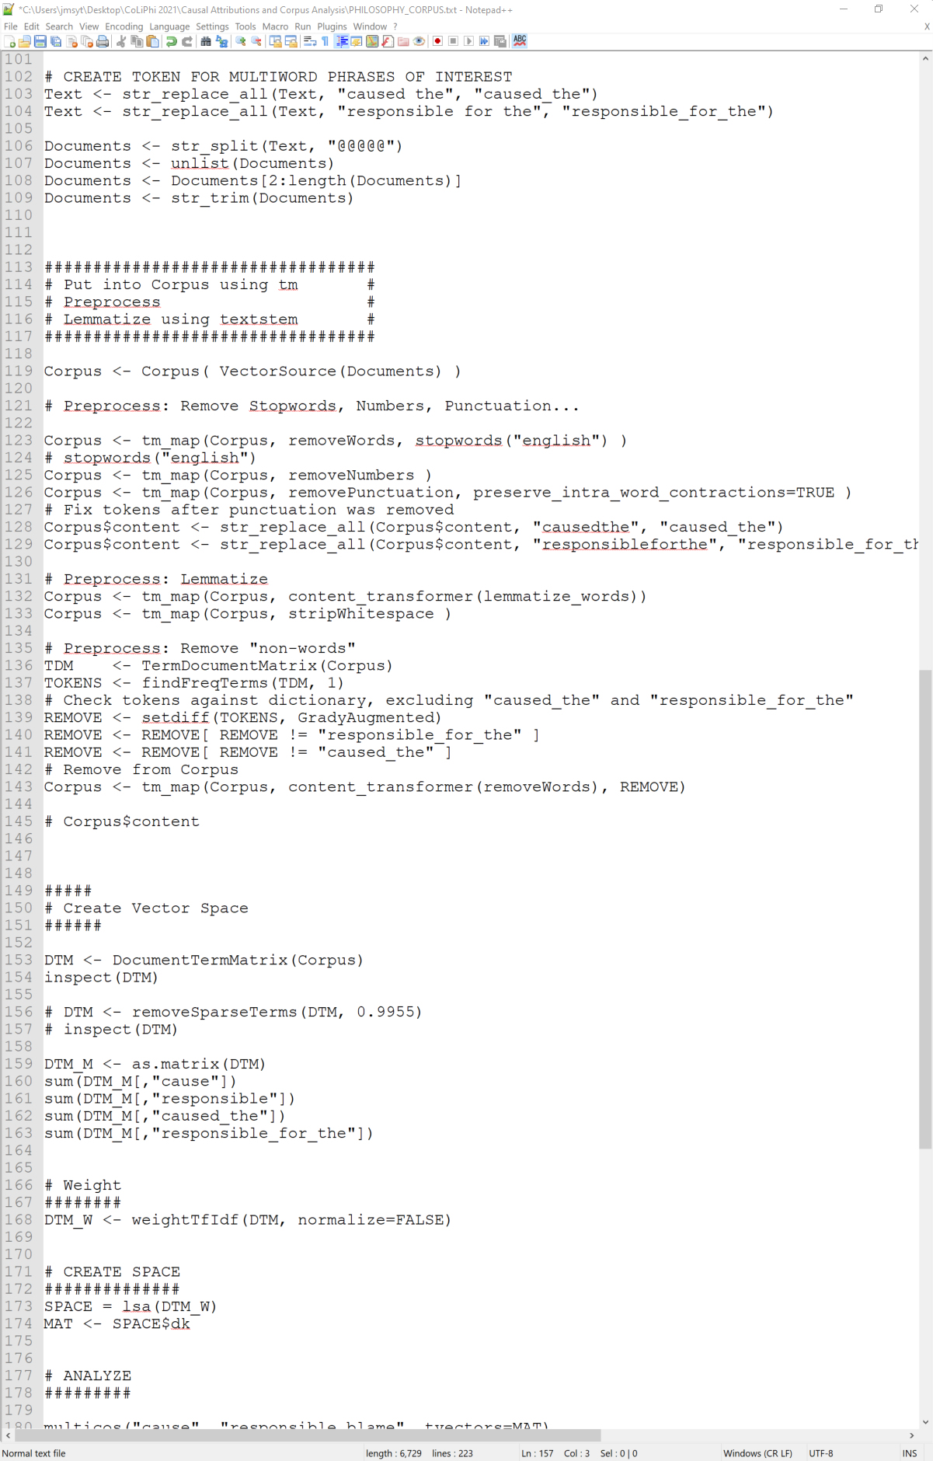
Build a corpus from the
documents using tm…
Do some further cleaning
Lemmatize (PoS tag, etc.)
Remove non-words (?)

Slide 68
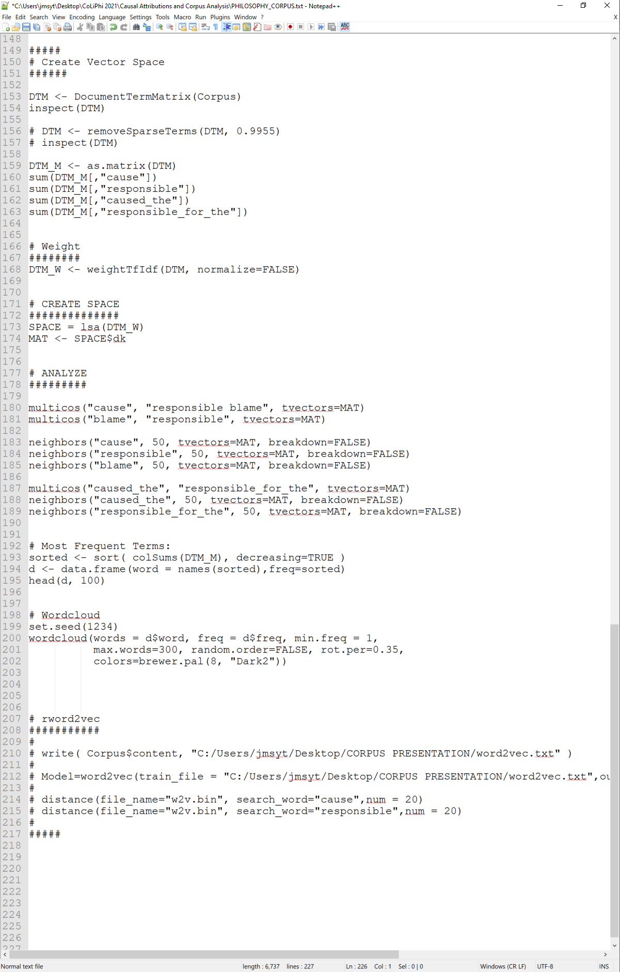
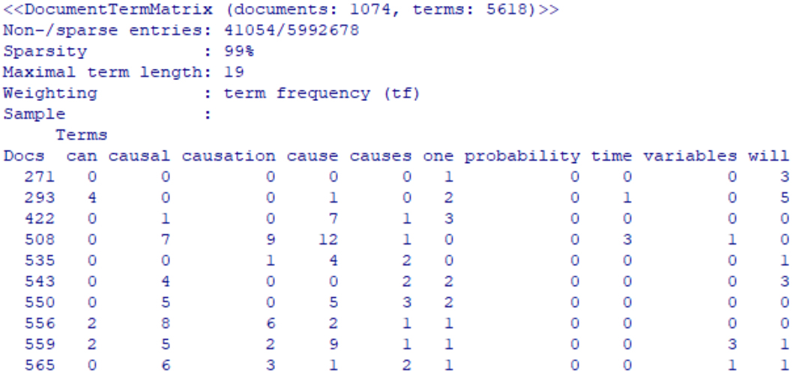
1074 documents comprised
of 5618 unique terms
1074x5618= 6033732= 41054+5992678
5992678 cells are 0
41054 cells are !0
Can reduce the sparsity
(removing infrequent terms),
which can help with memory
issues….

Slide 69


But make sure you didn’t
remove the terms you’re
interested in!

Slide 70



Can explore the space the
same way we did before!

Slide 71

Could also build a context-
predicting space in R,
although the implementation
is rather limited…

Slide 72

Let’s modify “PHILOSOPHY_CORPUS.txt”
to scrape the entries for:
abduction
abelard
abhidharma
abilities
abner-burgos
Then generate a wordcloud for those entries.

Slide 73


Slide 74

For creating spaces for larger corpora
(even the full text of the SEP), it is better to
switch to something like the Gensim toolkit
in Python…
COCA (non-academic)
lemmas
word2vec context-predicting model
(Spearman’s rho = 0.80)

Slide 75

Philosophy Corpus:
SEP and IEP; lemmatized, word2vec

Slide 76

Looking across these sets of analyses,
find evidence for a positive answer to each
of our four questions:
(1) Can corpus analysis provide independent support for the thesis that ordinary causal attributions are sensitive to normative information?
(2) Does the evidence coming from corpus analysis support the contention that outcome valence matters for ordinary causal attributions?
(3) Are ordinary causal attributions similar to responsibility attributions?
(4) Are causal attributions of philosophers different from causal attributions we find in corpora of more ordinary language?

Slide 77


